Slide 1
Using the Validation Board to Test your Startup Idea
Presented by: Sheryl B. Satorre, PhD.

Slide 2
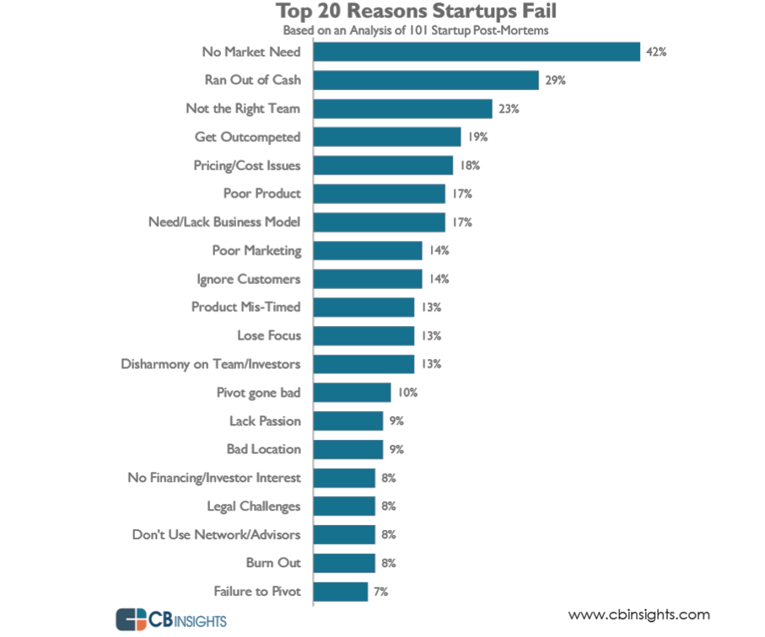

Slide 3
Customer Discovery → Research
Customer Research
Are you solving a problem (if yes, then which problem?) or are you providing people with something they will desire?
Why will they choose you over your competitors?
What would they be willing to pay for your application?
Market Research
Market size
The number of companies operate within the market
Competitors
Challenges in the market
Overall uniqueness of your application
Maturity of the market: Is it an established market or is it new?

Slide 4
Customer Validation Process
Success
Pursue!
Identify Success Criteria
Hypothesis
Design an Experiment
Test
Pivot!
Failure

Slide 5
What Grace learned from her failed startup?

Slide 6
Validation Board
The Validation Board is a great tool to help entrepreneurs stay focused on taking action while implementing the Lean Startup process.
simple tool for testing out your latest startup and product ideas
goal of using the validation board is to help entrepreneurs all over the world get out of the building and talk to customers
Tools: Javelin Board, Experiment Board, Simplified Validation Board

Slide 7
How to test your startup idea using validation board?
Start with hypotheses about your problem and customers.
List core assumptions about the problem.
Test your riskiest assumption.
Look for a “minimum success criterion.”

Slide 8
Stages of Validation
Exploration – Find PAIN
Pitch – Measure Demand
Concierge Technique – Productize

Slide 9
Possible Conclusions of a Customer Validation:
PIVOT – a substantive change in one or more business model canvas key components
PURSUE – a minor change in one or more business model canvas key components

Slide 11
“Fail fast. Learn Faster.”

Slide 12
“Good founders NEVER Fail. They just PIVOT.”

